Slide 1
welcome to
COMP 2691
Intermediate Windows Application Development in .NET
Week 8
COM and COM+
Amir Ahani, M.Sc. + MBA
Microsoft Certified Solution Developer (MCSD .NET)
Microsoft Certified Database Administrator (MCDBA)
Email: amirahani@gmail.com
<number> of 37
Notes:
COMP2690 Windows Application Development with C#

Slide 2
Today…
Working with Legacy Code
COM and COM+ Interoperability
Create and Manage .NET Components
Lab: Using ActiveX Controls on Windows Forms
Lab: Building COM Dynamic Link Library
Lab: Using the Type Library Importer Tool
Lab: Using COM Components Directly
Lab: Exposing .NET Components to COM
Lab: Using Platform Invoke with Windows API
<number> of 37
Notes:
COMP2690 Windows Application Development with C#

Slide 3
COM Components to .NET Components Migration
  Upgrade Path to .NET is Smooth
  If you design your applications as sets of COM servers and
  clients, you’ll find the upgrade path to .NET smooth. That’s
  because the .NET Framework includes good support for
  interoperating with existing COM-based code.
  From .NET components, you can easily instantiate and call
  COM components such as ActiveX controls or COM libraries.
  In fact, interoperability works in the other direction, too, with
  COM components able to call .NET code.
<number> of 37
Notes:
COMP2690 Windows Application Development with C#

Slide 4
ActiveX Controls
ActiveX Controls Communicate with the Host
The key advance underlying ActiveX controls is that they have a
standard set of interfaces through which they communicate with the
hosting form. By supporting these interfaces, any application can
make use of any ActiveX control, without any knowledge of the
internal workings of that control.
<number> of 37
Notes:
COMP2690 Windows Application Development with C#

Slide 5
Using ActiveX Controls
An ActiveX Control is Useless in the .NET World
.NET Framework Windows forms can only contain instances of
classes that are derived from the System.Windows.Forms class.
ActiveX controls, which are built using previous technologies, do
not derive from this class. So how can you possibly use an ActiveX
control on a Windows form?
The answer lies in the creation of a wrapper. In programming terms,
a wrapper is a layer of software whose job is to translate one set of
Interfaces into another. The System.Windows.Forms namespace
contains a wrapper class, AxHost, whose job is to make ActiveX
controls available to Windows forms.
<number> of 37
Notes:
COMP2690 Windows Application Development with C#

Slide 6
Using ActiveX Controls
AxHost Class
To a Windows form, AxHost class appears to be a regular Windows
forms control. To an ActiveX control, this class appears to be an
ActiveX control container. When the windows form sends a
message to the control, or vice versa, the wrapper class translates
the message so that the recipient component can understand it.
Importing ActiveX Controls
  The Windows Forms ActiveX Control Importer Tool (aximp.exe)
  Importing Controls with the Toolbox
  Using Classid
<number> of 37
Notes:
COMP2690 Windows Application Development with C#

Slide 7
Practical Tips
  ActiveX controls are not managed code, they do not get any of the protection that the CLR brings to your .NET applications.
  An ActiveX control is free to access memory that does not belong to it or indulge in other buggy behavior that might crash the entire application.
  IE Only: Internet explorer functions as an ActiveX host, but other browsers are offer little or no support for ActiveX controls.
<number> of 37
Notes:
COMP2690 Windows Application Development with C#

Slide 8
Using ActiveX Controls
Using the Windows Forms ActiveX Importer Tool
1. Create a new folder on your hard drive to house the imported control.
2. Launch a .NET command prompt.
3. Inside the command prompt window, navigate to the folder that you
created in step 1.
4. Enter this command line to run the importer:
aximp c:\winnt\system32\sysinfo.ocx
OR aximp c:\winnt\system32\msdxm.ocx
The importer lists the names of the files that it creates as part of the
import process:
SysInfoLib.dll , AxSysInfoLib.dll
OR MediaPlayer.dll , AxMediaPlayer.dll
<number> of 37
Notes:
COMP2690 Windows Application Development with C#

Slide 9
Using ActiveX Controls
5. Open a Visual C# .NET Windows application and add a new form to
the project. Right-click the Project node in Solution Explorer and select
Add Reference. Select the COM tab in the Add Reference dialog box.
Browse to the folder you created in step 1. Add references to both
SysInfoLib.dll and AxSysInfoLib.dll. (OR MediaPlayer.dll and
AxMediaPlayer.dll)
public class … : System.Windows.Forms.Form
{
/// <summary>
/// Required designer variable.
/// </summary>
private System.ComponentModel.Container components = null;
//private AxSysInfoLib.AxSysInfo sysInfo1;
private AxMediaPlayer.AxMediaPlayer mp1;
}
<number> of 37
Notes:
COMP2690 Windows Application Development with C#

Slide 10
Using ActiveX Controls
Using the Toolbox to Add an ActiveX Control to a Form
You can use the toolbox to add any ActiveX control from your system to
the .NET environment.
1. Create a new form in your Visual C# .NET application.
2. Select the General tab in the Toolbox.
3. Right-click the toolbox and select Choose Items and then select the
COM components tab
4. Scroll down the list of components, which should include all the
ActiveX controls that are registered on your computer, until you find
the control you want to add to your project. Click the check box for
the control (For example select the Microsoft Masked Edit control).0
<number> of 37
Notes:
COMP2690 Windows Application Development with C#

Slide 11
Using ActiveX Controls
5. The new control shows up at the bottom of the toolbox, Place an
instance of the Masked Edit control on your form. Set the Mask
property of the Masked Edit control to ##/##/##.
6. Run the project. The form accepts only the numeric characters
allowed by the Masked Edit control.
<number> of 37
Notes:
COMP2690 Windows Application Development with C#

Slide 12
Practical Tips
First and foremost, you should recognize that there’s an inevitable
performance decrease when you use ActiveX controls on a .NET
form. Although the wrapper architecture allows you to seamlessly
use an ActiveX control, it imposes a performance penalty. That’s
because every call to the control is actually a call to the wrapper
class, which then must call the control itself after suitably transforming
the parameters of the call. Thus your code has to do twice as much
work to interact with an ActiveX control as with a native .NET control. If
you’re using only a few ActiveX controls in a limited number of forms,
this performance decrease might not be noticeable, but if you overuse
ActiveX controls, it adds up.
<number> of 37
Notes:
COMP2690 Windows Application Development with C#

Slide 13
Using COM Components
No need to do a big bang migration all at once
Fortunately, if your old programs use COM architecture, you don’t have
to do a “big bang” migration all at once.
.NET components can call COM components, and COM components
can call .NET components. This means that you can migrate one
component (a control, a class library, and so on) at a time, and still keep
all your code working together.
<number> of 37
Notes:
COMP2690 Windows Application Development with C#

Slide 14
Using COM Components
Why might you want to use legacy COM component?
There are four basic reasons for maintaining part of a system in
COM components while moving other parts to .NET components:
1) It takes time to learn enough about Visual C# .NET and the .NET
Framework to be productive. While you’re making your way up the
learning curve, you may have to continue development of existing
COM components.
2) You may have components that can’t be easily moved to .NET
because they use language features that are no longer supported
or because of other implementation quirks.
3) It takes time to move code from one system to the other. Unless you
can afford extended downtime, a gradual move lets you write the
converted code at a slower pace.
4) Your application may depend on third-party controls or libraries for
which you do not have the source code.
<number> of 37
Notes:
COMP2690 Windows Application Development with C#

Slide 15
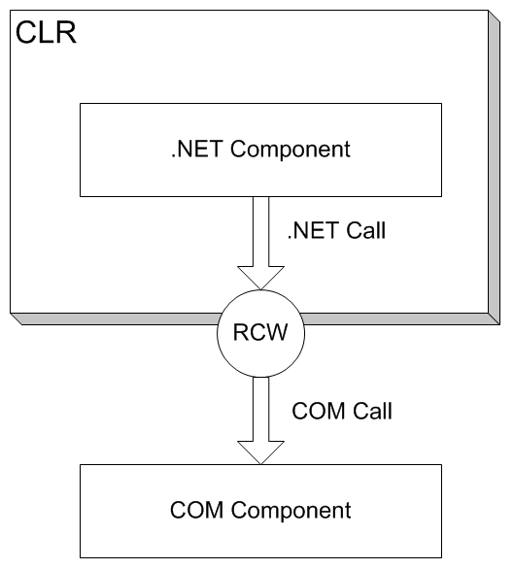
Understanding Runtime Callable Wrapper
Managed Code and Unmanaged Code
Visual C# .NET creates code that operates within the .NET CLR.
Code that operates within the CLR is called managed code.
Managed code benefits from the services that the CLR offers,
including garbage collection, memory management, and support
for versioning and security.
Code that does not operate within the CLR is called unmanaged
code. Code that was created by tools that are older than the .NET
Framework is by definition unmanaged code. COM components are
unmanaged code because COM was designed before the CLR
existed, and COM components don’t make use of any of the
services of the CLR.
Managed code expects that all the code with which it interacts
will use the CLR. This is an obvious problem for COM
components.
How can you take a component that was developed before the
advent of .NET and make it look like a .NET component to other
.NET components?
The answer is to use a proxy. In general terms, a proxy accepts
commands and messages from one component, modifies them,
and passes them to another component. The particular type of
proxy that allows you to use COM components within a .NET
application is called a Runtime Callable Wrapper (RCW). Hence,
it’s a proxy that can be called by the CLR.
<number> of 37
Notes:
COMP2690 Windows Application Development with C#

Slide 16
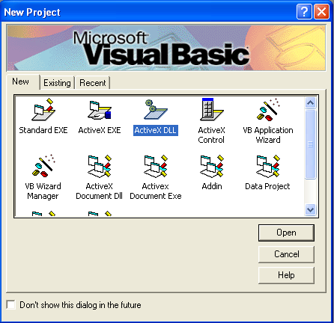
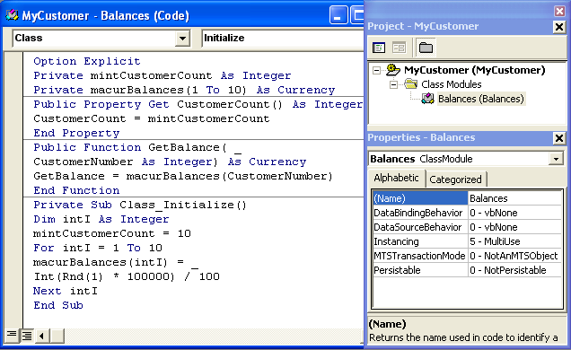
Building COM Dynamic Library
Option Explicit
Private mintCustomerCount As Integer
Private macurBalances(1 To 10) As Currency
Public Property Get CustomerCount() As Integer
CustomerCount = mintCustomerCount
End Property
Public Function GetBalance( _
CustomerNumber As Integer) As Currency
GetBalance = macurBalances(CustomerNumber)
End Function
Private Sub Class_Initialize()
Dim intI As Integer
mintCustomerCount = 10
For intI = 1 To 10
macurBalances(intI) = Int(Rnd(1) * 100000) / 100
Next intI
End Sub
Microsoft Visual Basic uses the linear-congruential method for pseudo-random number generation in the RND function. The following pseudo code documents the algorithm used:
x1 = ( x0 * a + c ) MOD (2^24)
where:
x1 = new value
x0 = previous value (an initial value of 327680)
a = 1140671485
c = 12820163
The 'MOD' operator in the formula above returns the integer remainder after an integer division.
The expression x1/(2^24) will then return the floating-point number between 0.0 and 1.0 that is returned by the RND function.
  1. Launch Visual Basic 6. Create a new ActiveX DLL project.
  2. Select the Project1 node in the Project Explorer window and
  rename it MyCustomer.
  3. Select the Class1 node in the Project Explorer window and
  rename it Balances.
  4. Add this code to the Balances class:
<number> of 37
Notes:
COMP2690 Windows Application Development with C#

Slide 17
Building COM Dynamic Library
5. Save the Visual Basic project.
6. Select File, Make MyCustomer.dll to create the COM component.
<number> of 37
Notes:
COMP2690 Windows Application Development with C#

Slide 18
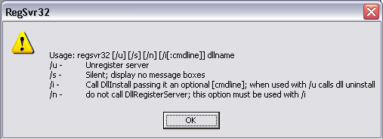
Practical Tip
COM DLL Needs to Be Registered Before It Is Used
MyCustomer.dll will not be in the COM tab of the Add Reference dialog box if it was not built in the VB 6 IDE. When you build the DLL using Visual Basic 6.0, it automatically registers the DLL in Windows Registry.
If you are using the code files from the CD, or from the Internet you will need to register MyCustomer.dll using regsvr32.exe, as shown here, before selecting it in the COM tab:
regsvr32 MyCustomer.dll
<number> of 37
Notes:
COMP2690 Windows Application Development with C#

Slide 19
Using the Type Library Importer Tool
The task of using COM components from the .NET Framework is
substantially facilitated by the fact that COM components, like
.NET components, have metadata that describes their interfaces.
For .NET components, the metadata is embedded in the assembly
manifest.
For COM components, the metadata is stored in a type library.
A type library can be a separate file, or (as with Visual Basic 6 class
libraries) it can be embedded within another file.
The .NET Framework includes a tool, the Type Library Importer
tool (tlbimp.exe), that can create an RCW from COM metadata
contained in a type library.
<number> of 37
Notes:
COMP2690 Windows Application Development with C#

Slide 20
Using the Type Library Importer Tool
1. Launch a .NET command prompt by selecting Start, Programs,
Microsoft Visual Studio .NET, Visual Studio .NET Tools, Visual
Studio .NET Command Prompt.
2. Inside the command prompt window, navigate to the folder that
contains the MyCustomer.dll COM library.
3. Enter this command line to run the Type Library Importer:
tlbimp MyCustomer.dll /out:NETMyCustomer.dll
4. Add a new Windows form to your Visual C# application.
5. Place three Label controls, three TextBox controls
(txtCustomerCount, txtCustomerNumber, and txtBalance), and a
Button control (btnGetBalance), on the form.
6. Right-click the Project node in Solution Explorer and select
Add Reference.
7. Click the Browse button in the Add Reference dialog box. Browse
to the NETMyCustomer.dll file that you created in step 3. Click OK
to add the reference to the project.
8. Switch to the form’s code view and add the following using
directive: using NETMyCustomer;
<number> of 37
Notes:
COMP2690 Windows Application Development with C#

Slide 21
Using the Type Library Importer Tool
9. Double-click the form and the Button control and enter the following
code in the event handlers:
10. Enter a number between 1 and 10 in the Customer Number
TextBox control and click the Get Balance button to see that
customer’s balance.
Balances b;
protected void Page_Load(object sender, EventArgs e)
{
b = new Balances();
txtCustomerCount.Text = b.CustomerCount.ToString();
}
protected void btnGetBalance_Click(object sender, EventArgs e)
{
Int16 custNumber = Int16.Parse(txtCustomerNumber.Text);
txtBalance.Text = b.GetBalance(ref custNumber).ToString();
}
<number> of 37
Notes:
COMP2690 Windows Application Development with C#

Slide 22
Practical Tip
.NET users should have write access to the directory containing the Type Library importer is used to create an RCW for the COM type library. This RCW is a library that you can add to your .NET project as a reference. After you do that, the classes in the COM component can be used just like native .NET classes.
When you use a class from the COM component, .NET makes the call to the RCW, which in turn forwards the call to the original COM component and returns the results to your .NET managed code.
.NET users should have write access to the directory containing COM dlls.
<number> of 37
Notes:
COMP2690 Windows Application Development with C#

Slide 23
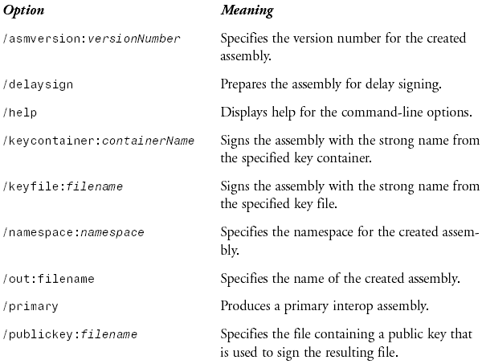
Using the Type Library Importer Tool
  Command-Line options for the Type Library Importer (tlbimp.exe) :
<number> of 37
Notes:
COMP2690 Windows Application Development with C#

Slide 24
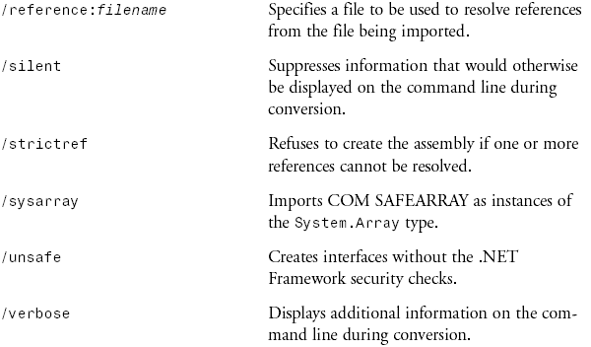
Using the Type Library Importer Tool
  Command-Line options for the Type Library Importer (tlbimp.exe) :
<number> of 37
Notes:
COMP2690 Windows Application Development with C#

Slide 25
Using COM Components Directly
1) For a COM component that will only be used in a single Visual C# .NET project and that you wrote yourself, use the easiest method: direct reference from the .NET project. This method is suitable only for a truly private component that does not need to be shared by the other projects.
2) If a COM component is shared among multiple projects, use the Type Library Importer so that you can sign the resulting assembly and place it in the global assembly cache (GAC). Shared code must be signed.
3) If you need to control details of the created assembly—such as its name, namespace, or version number—you must use the Type Library Importer. The direct reference method gives you no control over the details of the created assembly.
As with ActiveX controls, the visual Studio .NET interface provides
a streamlined way to use a COM component from your .NET code.
When you directly reference a COM library from the Visual Studio
.NET Integrated Development Environment (IDE), the effect is
almost the same as if you used the Type Library Importer to import
the same library. Visual Studio .NET creates a new namespace with
the name of the original library and then exposes the classes from
the library within that namespace.
Although you can use either of the two methods described in this
section to call a COM component from a .NET component, there
are reasons to prefer one method over the other:
<number> of 37
Notes:
COMP2690 Windows Application Development with C#

Slide 26
Using Direct Reference with a COM Library
MyCustomer.Balances b;
protected void Page_Load(object sender, EventArgs e)
{
b = new MyCustomer.Balances();
txtCustomerCount.Text = b.CustomerCount.ToString();
}
protected void btnGetBalance_Click(object sender, EventArgs e)
{
Int16 custNumber = Int16.Parse(txtCustomerNumber.Text);
txtBalance.Text = b.GetBalance(ref custNumber).ToString();
}
1. Add a new form to your Visual C# application.
2. Place three Label controls, three TextBox controls
(txtCustomerCount, txtCustomerNumber, and txtBalance), and a Button
control (btnGetBalance), on the form.
3. Right-click the Project node in Solution Explorer and select Add Reference.
4. Select the COM tab in the Add Reference dialog box. Scroll down the list of
COM components until you come to the MyCustomer library. Select the
MyCustomer library, click Select, and then click OK.
5. Switch to the code view and enter the following code in the class definition; attach the handlers required.
6. Enter a number between 1 and 10 in the Customer Number
TextBox control and click the Get Balance button to see that
customer’s balance.
<number> of 37
Notes:
COMP2690 Windows Application Development with C#

Slide 27
Exposing .NET Component to COM
Just as COM components can be consumed by .NET applications, the
reverse is true. When .NET components are consumed by COM, a
proxy known as a COM Callable Wrapper (CCW) handles marshaling
items between .NET and COM.
1- Create a .NET class library just like you normally would.
2- Open the project properties dialog box by right-clicking the project
and selecting properties.
3- Click the Build tab, which is located on the right side of the dialog
box.
4- Select the Register for COM Interop option in the output section of
the tab, as shown in the following figure.
5- Build the application.
<number> of 37
Notes:
COMP2690 Windows Application Development with C#

Slide 28
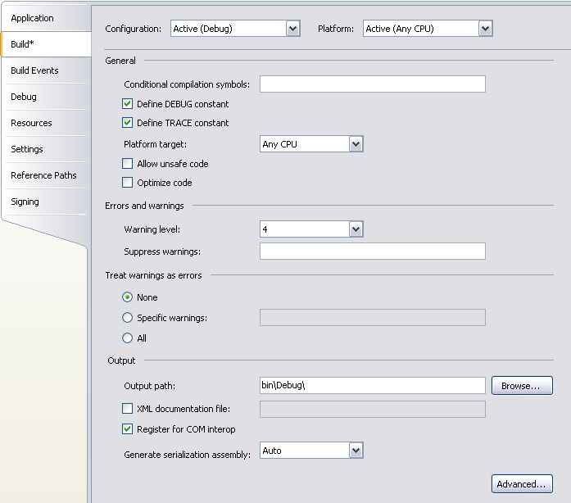
Exposing .NET Component to COM
After the project is built, the necessary type library information will
be created by Visual Studio 2005, which will also register each of
the objects as COM objects for you. The following listing is an
example of code you might use in your projects to create a .NET
component that can be used by COM.
If you compile the application with the following code and there are
no errors, the assembly will be visible to COM.
using System;
using System.Collections.Generic;
using System.Text;
namespace NetForComDemoCS
{
public class ComVisiblePerson
{
private string firstName; private string lastName;
public string FirstName
{
get { return firstName; }
set { firstName = value; }
}
public string LastName
{
get { return lastName; }
set { lastName = value; }
}
}
}
<number> of 37
Notes:
COMP2690 Windows Application Development with C#

Slide 29
Using PInvoke
There is another way that the .NET Framework can interoperate
with unmanaged code: through functional calls to unmanaged
libraries. The PInvoke feature of .NET allows .NET code to call
functions from unmanaged libraries such as the Windows API.
<number> of 37
Notes:
COMP2690 Windows Application Development with C#

Slide 30
Using PInvoke with the Windows API
1. Add a new form to your Visual C# application.
2. Place a Label control named lblComputerName on the form.
3. Switch to code view. Add the following using directives to
the top of your code:
using System.Text;
using System.Runtime.InteropServices;
4. Add the following lines of code in the class definition, which indicates
that the GetComputerName() method is implemented in kernel32.dll:
[DllImport(“kernel32.dll”, CharSet=CharSet.Auto)]
public static extern int GetComputerName(StringBuilder buffer, ref uint size);
<number> of 37
Notes:
COMP2690 Windows Application Development with C#

Slide 31
Using PInvoke with the Windows API
5. Add this code to Page_Load() event handler:
StringBuilder sbBuf = new StringBuilder(128);
UInt32 intLen = (uint)sbBuf.Capacity;
Int32 intRet = 0;
intRet = GetComputerName(sbBuf, ref intLen);
lblComputerName.Text = "This computer is named " + sbBuf.ToString();
6. Run the project. The form displays the name of the computer where the
code is run.
<number> of 37
Notes:
COMP2690 Windows Application Development with C#

Slide 32
Using COM+ Components
COM+ is the component services layer of Windows 2000 and later
operating systems. COM+ supplies a number of services to
components running under Windows, including the following:
  Role-based security
  Object pooling and reusability
  Queued components for asynchronous calls
  Transactional processing
  A publish-and-subscribe events model
<number> of 37
Notes:
COMP2690 Windows Application Development with C#

Slide 33
Using COM+ Components
Despite the significant differences between COM+ and straight
COM, you do not have to do anything different to use a COM+
component than to use a COM component. To the consumer, a
COM+ component looks much like a COM component. The Type
Library Importer tool and Visual Studio .NET can both create
wrappers for COM+ components, using the same procedures that
they use for COM components.
<number> of 37
Notes:
COMP2690 Windows Application Development with C#

Slide 34
Evolution of Component Services
Historically, enterprise applications were written as large monolithic programs that ran
on powerful but expensive mainframe computers.
Over time, with experience developing monolithic applications and with the modern
advancements in the personal computer technology, system architects were able to
make some observations:
  It would be much better to write code as reusable components instead of monolithic
  tomes. Assembling an application from reusable components would be faster and
  cheaper because of the time saved in coding and testing.
  It would be much better if applications could talk to each other. It would be much
  more useful to have integrated applications working together than closed
  applications that could not understand each other.
  With the increasing power of personal computers, it would be a good idea to break
  down the application in multiple layers, each running on one or more personal
  computers. This way, the complete application could run on a set of inexpensive
  computers networked with each other, rather than expensive mainframes.
  These observations were the foundation of the component-based distributed
  application development systems that would evolve over the next several years on
  the Windows platforms.
<number> of 37
Notes:
COMP2690 Windows Application Development with C#

Slide 35
Summary
  COM components can easily be consumed in a .NET application, although the reasons for doing so need to be carefully considered.
  You can use the COM tab of the Add Reference dialog box to add a reference to registered COM components.
  The TlbImp.exe tool is a command-line mechanism to import a COM component.
  The out switch of the TlbImp.exe tool can be used to change the name of the assembly that will be imported from its original name to a preferred one.
<number> of 37
Notes:
COMP2690 Windows Application Development with C#

Slide 36
Summary
  The Register For COM Interop option under the build configuration automates the process of exposing .NET assemblies to COM components.
  The primary mechanism for exposing .NET assemblies to COM components is the ComVisible attribute.
  The ComVisible attribute can be set to apply to an entire assembly, an entire class, or individual members.
<number> of 37
Notes:
COMP2690 Windows Application Development with C#

Slide 37
Summary
  The .NET Framework provides a mechanism to call Windows API calls and unmanaged code through Platform Invoke.
  To use P/Invoke, you use the DllImport attribute and the name of the DLL you are referencing.
  You must use the private and static/shared attributes for P/Invoke calls.
  To allow default positioning in a structure that’s to be marshaled, you can use the Layout.Sequential attribute.
  To specify a value for the positioning in a structure, you can use the Layout.Explicit attribute.
<number> of 37
Notes:
COMP2690 Windows Application Development with C#

